Slide 1

Foundation,Strategy and Shared Understanding
By Simon

Slide 2
TABLE OF CONTENTS
03
08
How does odoo work at HL?
What is ERP?
04
08
What is ERP Project?
What is Odoo good at and its limitation?
011
05
What is Odoo?
Why Use odoo?
018
018
Odoo Philosophy
Who uses odoo?

Slide 3
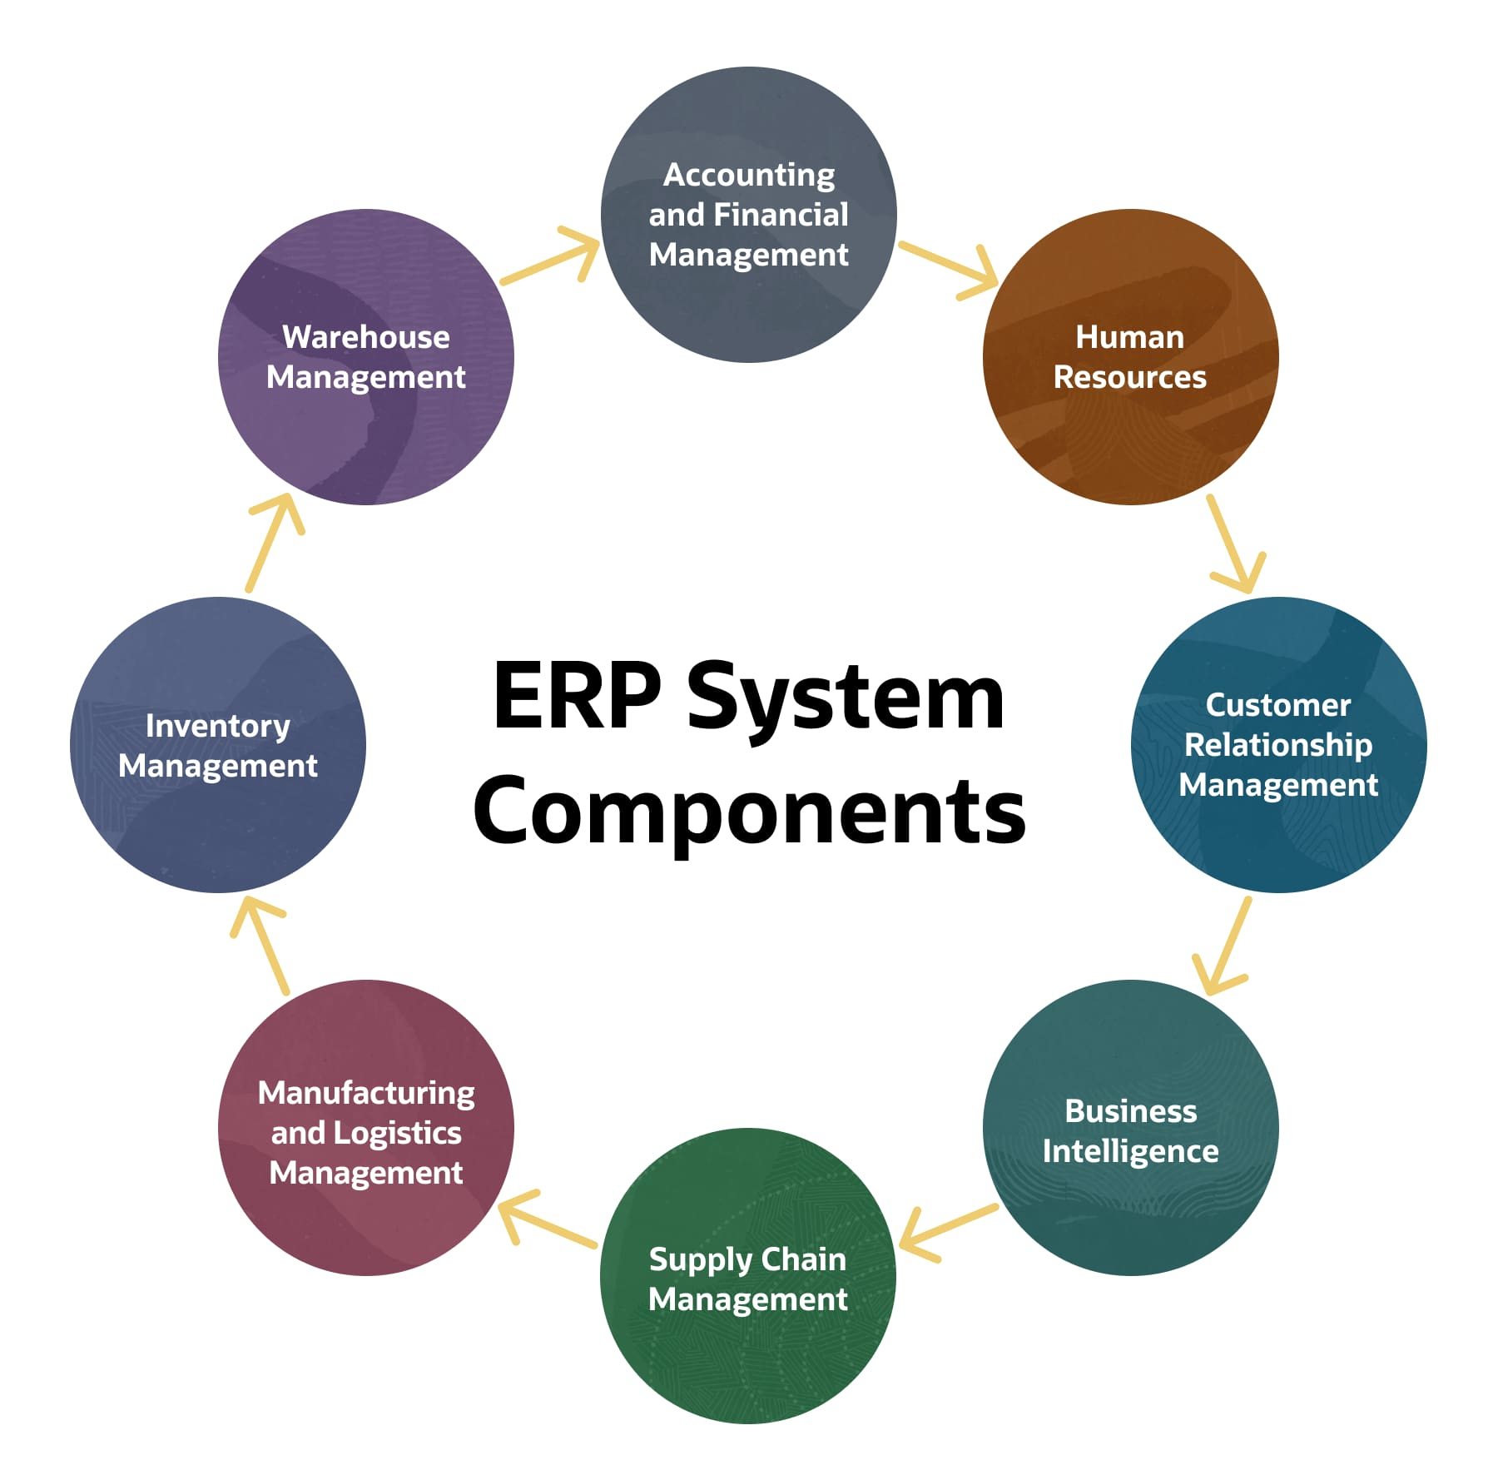
03
WHAT IS ERP?
ERP is a Enterprise Resource Planning.
Unified software system that helps an organization run all its core business processes in one place.

Slide 4
04
WHAT IS ERP Project?
ERP Project is the full process of planning, selecting, implementing, customizing, and rolling out an ERP system in an organization.
A temporary project with a set budget, timeline,deliverable
Understanding how business works
Generally it’s a journey of implementing ERP System

Slide 5
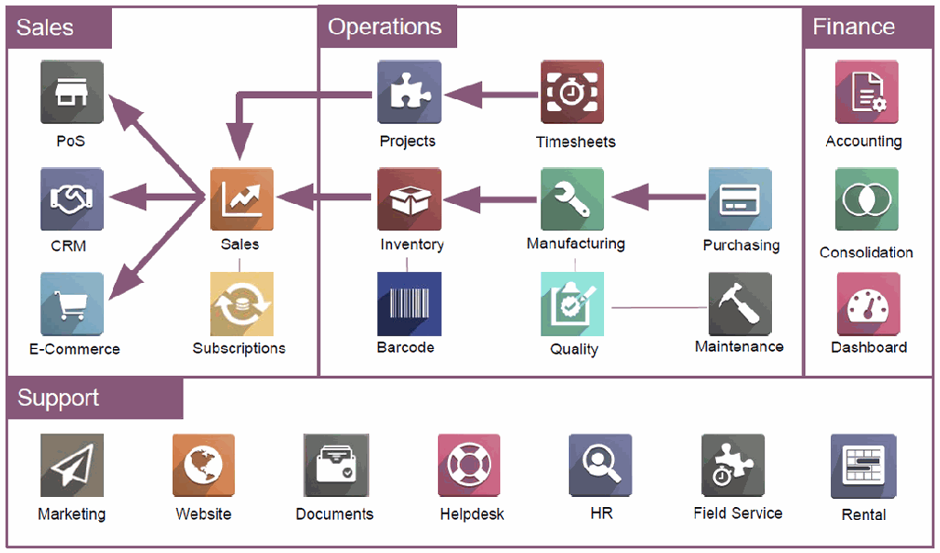
05
WHAT IS Odoo?
Is an all-in-one, modular ERP that allows
companies to manage everything in one
unified system.
Developed by odoo

Slide 6
04
WHAT IS Odoo?....
Is A Development Framework
Built on Python + XML + JS
A Unified Database
Every app shares one data model

Slide 7
05
WHAT IS Odoo?....
Is A Development Framework
Built on Python + XML + JS+OWL
A Unified Database
Everything runs on a single unified database

Slide 8
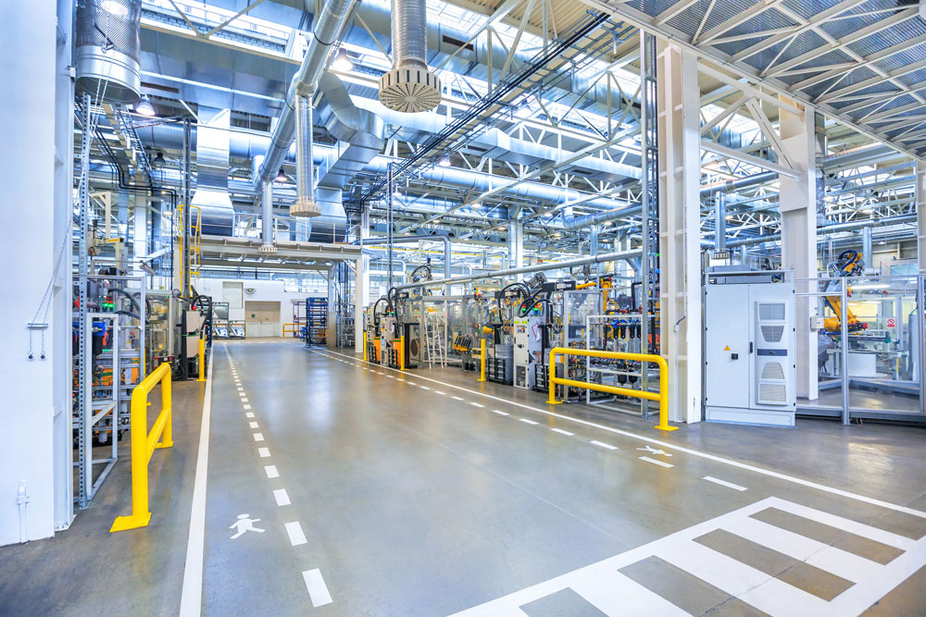

Slide 9


Slide 10
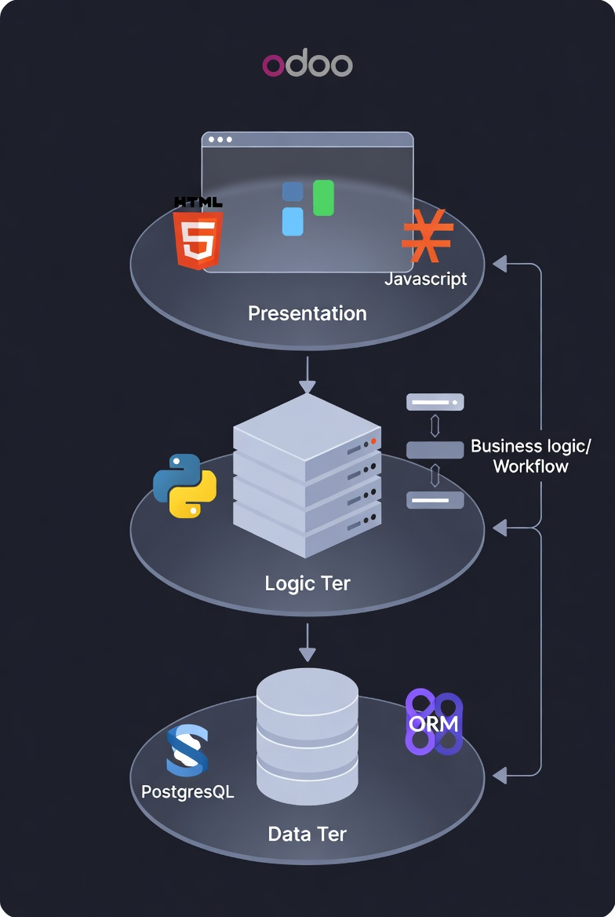
08
How does Odoo works at HL?....

Slide 11
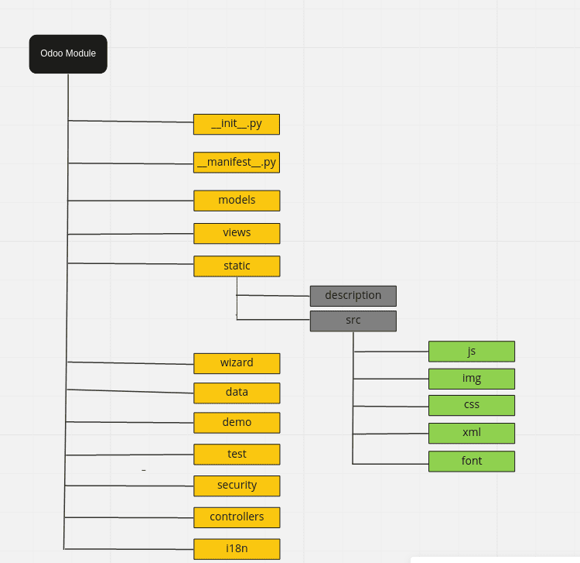
07
How does Each module works at HL?....

Slide 12
010
WHAT IS Odoo Good at?....
Modular and Highly Flexible
Odoo works like a building foundation you can start small with a few apps and gradually build up as the business grows.
Strong customization capabilities
Developers can modify any module, extend workflows, add new fields, create custom views, and tailor business logic to fit unique needs.
Modern, Intuitive, and User-Friendly Interface

Slide 13
010
WHAT IS Odoo Good at?....
Easy Integration With External Systems
Odoo connects smoothly with third-party platforms through APIs, enabling seamless data flow.
Comprehensive Documentation
Well-structured reference materials support both users and developers in understanding and extending the system
Strong and Active Community
A global ecosystem of contributors, developers, and partners continuously enriches modules, support resources, and innovations.

Slide 14
012
WHAT IS Odoo limitation?....
Monolithic Architecture
Is a highly coupled monolithic system.
If one core module breaks (e.g Sales), it can disrupt dependent modules (Inventory, Accounting, Invoicing).
A single failure in a model, view, or server logic can impact the entire system.
Harder to identify issues, error sometimes.

Slide 15


015
Why Use Odoo?
◦ Large Open Source Community: ODOO is open source and supported by developers around the world.
◦ Extensive Documentation: Official documentation and tutorials are freely available.
◦ Third-Party modules: Wide variety of reusable apps,

Slide 16
016
Who Use Odoo?
◦ Small & Medium Businesses
◦ Startups & Growing Companies
◦ Manufacturers & Distributors
◦ Enterprise companies

Slide 17


017
Who Uses Odoo?
OTech
Around 18,000–30,000
Toyota
KUSO

Slide 18



018
Odoo Philosopy
1
Understand the foundation
2
Add module
3
DRY (Don’t Repeat Yourself)

Slide 19
019
Final Say
◦ Customization
◦ Brand
◦ Microservice

Slide 20
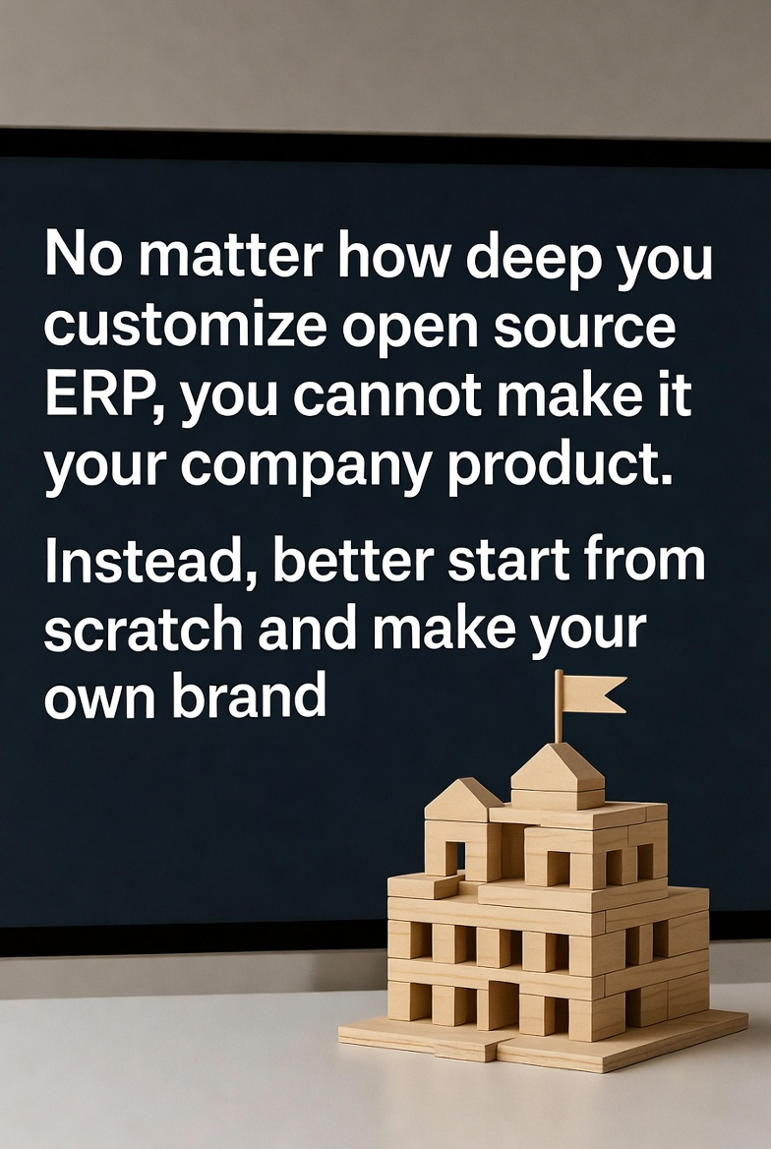
020
Final Say

Slide 21
THANK YOU

